Slide 1
Climbing the (Elastic) Beanstalk
One developer's journey from Amazon Web Services newbie to system admin of a brand new, HITRUST-Certified application in the AWS cloud.
Kris Hatcher
Development Lead @ Smart Data

Slide 2
My Name Is Kris Hatcher
Developer with over 15 years experience
Certified Scrum Master with experience on teams ranging from 2 to 20 people
AWS Certified Solutions Architect with experience on a variety of systems from single app deployments to several multi-tenant apps in a single account
Science Fiction TV fan, enjoy all Star Trek (except original series) but prefer Stargate: SG-1 & Atlantis
Enjoy MCU movies a lot! #CaptainRogers (I haven’t seen Infinity Wars yet, so NO SPOILERS!!!)

Slide 3

I work for Smart Data
50+ Staff Members
Primarily focus on Cincinnati and Dayton markets
Currently have clients across the Eastern United States
Focus on consistent, reliable delivery of software by using Agile Principles and close, active discussion with Product Owners

Slide 4
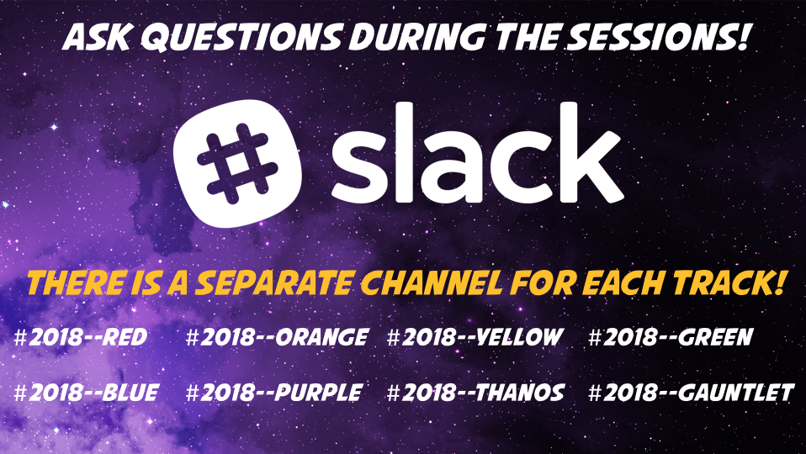

Slide 5
The Client & Project
Notes:
Introduce CareStar Information Systems & Ohio Homecare Waiver

Slide 6
Client
Software as a Service company, specializing in
Healthcare Case Management
Assessments
Reporting
Primary clients
Government Agencies
Managed Care Organizations
Case Management Agencies

Slide 7
Project
Rewrite legacy case management and assessment application from scratch
Support expanded assessment capabilities in new system
Migrate users and content from legacy application to new application with minimal downtime
Make use of modern infrastructure technologies for new platform in order to support cost-savings through scalability and flexibility

Slide 8
Back Story
Client faced significant financial pressure and reduced their internal development staff, moving their support development to a sub-contracting development firm.
After using that firm for several years, the Client became unable to meet timelines promised to clients and had significant problems communicating with the firm’s development team.
These and other problems drove the Client to look for a new partner in their efforts to complete work for their clients.

Slide 9
Back Story
The Client approached Smart Data about the possibility of assisting with their development efforts in the Fall of 2016.
Smart Data assembled a team dedicated to the Client and began working to understand the scope of the project.
The Client & Smart Data faced significant problems while attempting to move development work (including source code and infrastructure resources) from the previous firm to Smart Data.

Slide 10
Initial Infrastructure
Unit Testing framework was in place, but completely unused
No part of deployment was automated
Manually created & deployed AMIs
Manually configured AWS environments, including scaling rules
No standardization of naming, and use of multiple AWS Regions, resulted in an inability to know what resources were in Production use and what were for various testing environments
Notes:
Discuss “current state” of the system when we took over

Slide 11
Security Concerns
Application handles Personally Identifiable Information (PII) and Protected Health Information (PHI) & must follow guidelines put forth in the Health Insurance Portability and Accountability Act (HIPAA) and Health Information Technology for Economic and Clinical Health (HITECH) Act

Slide 12
Amazon Web Services

Slide 13
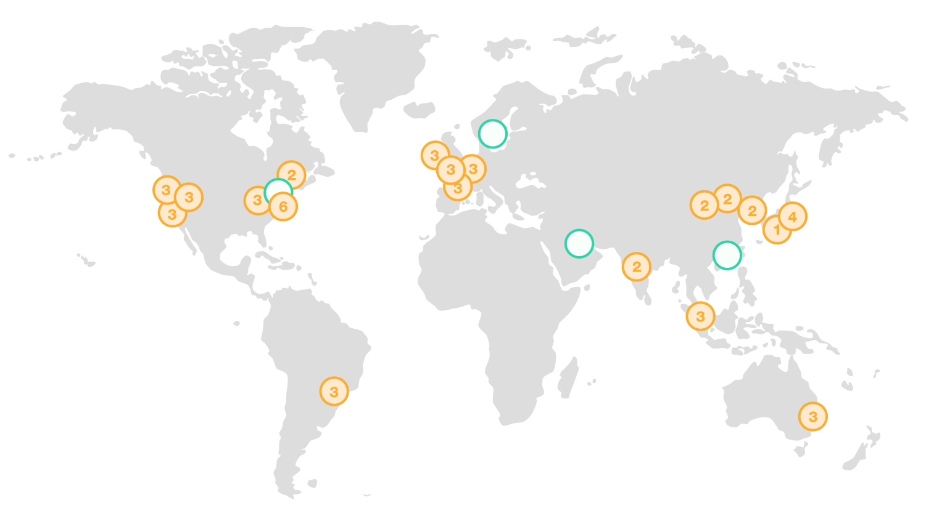
Notes:
Currently:
54 AZs
19 Regions
Announced:
+12 AZs
+4 Regions

Slide 14
Regions & Availability Zones

Slide 15
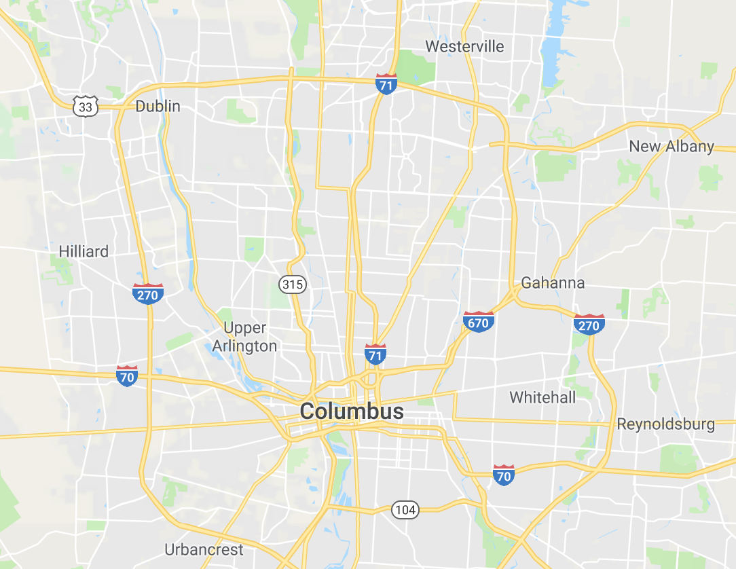

Regions & Availability Zones
Region = Columbus (us-east-2)
AZ 1 = Dublin (us-east-2a)
AZ 2 = Hilliard (us-east-2b)
AZ 3 = New Albany (us-east-2c)
Notes:
AWS AZ “ids” are not static, but are randomly assigned per account. And, different accounts may have access to different ones.
For example: New customers can access two EC2 Availability Zones in US West (Northern California), despite the fact that there are actually 3 AZs in that Region.

Slide 16
Glossary
Instance = Server
AZ = Availability Zone (datacenter)
VPC = Virtual Private Cloud (network)
EC2 = Elastic Cloud Compute (server)
AMI = Amazon Machine Image
RDS = Relational Database Service
S3 = Simple Storage Service
EB = Elastic Beanstalk

Slide 17
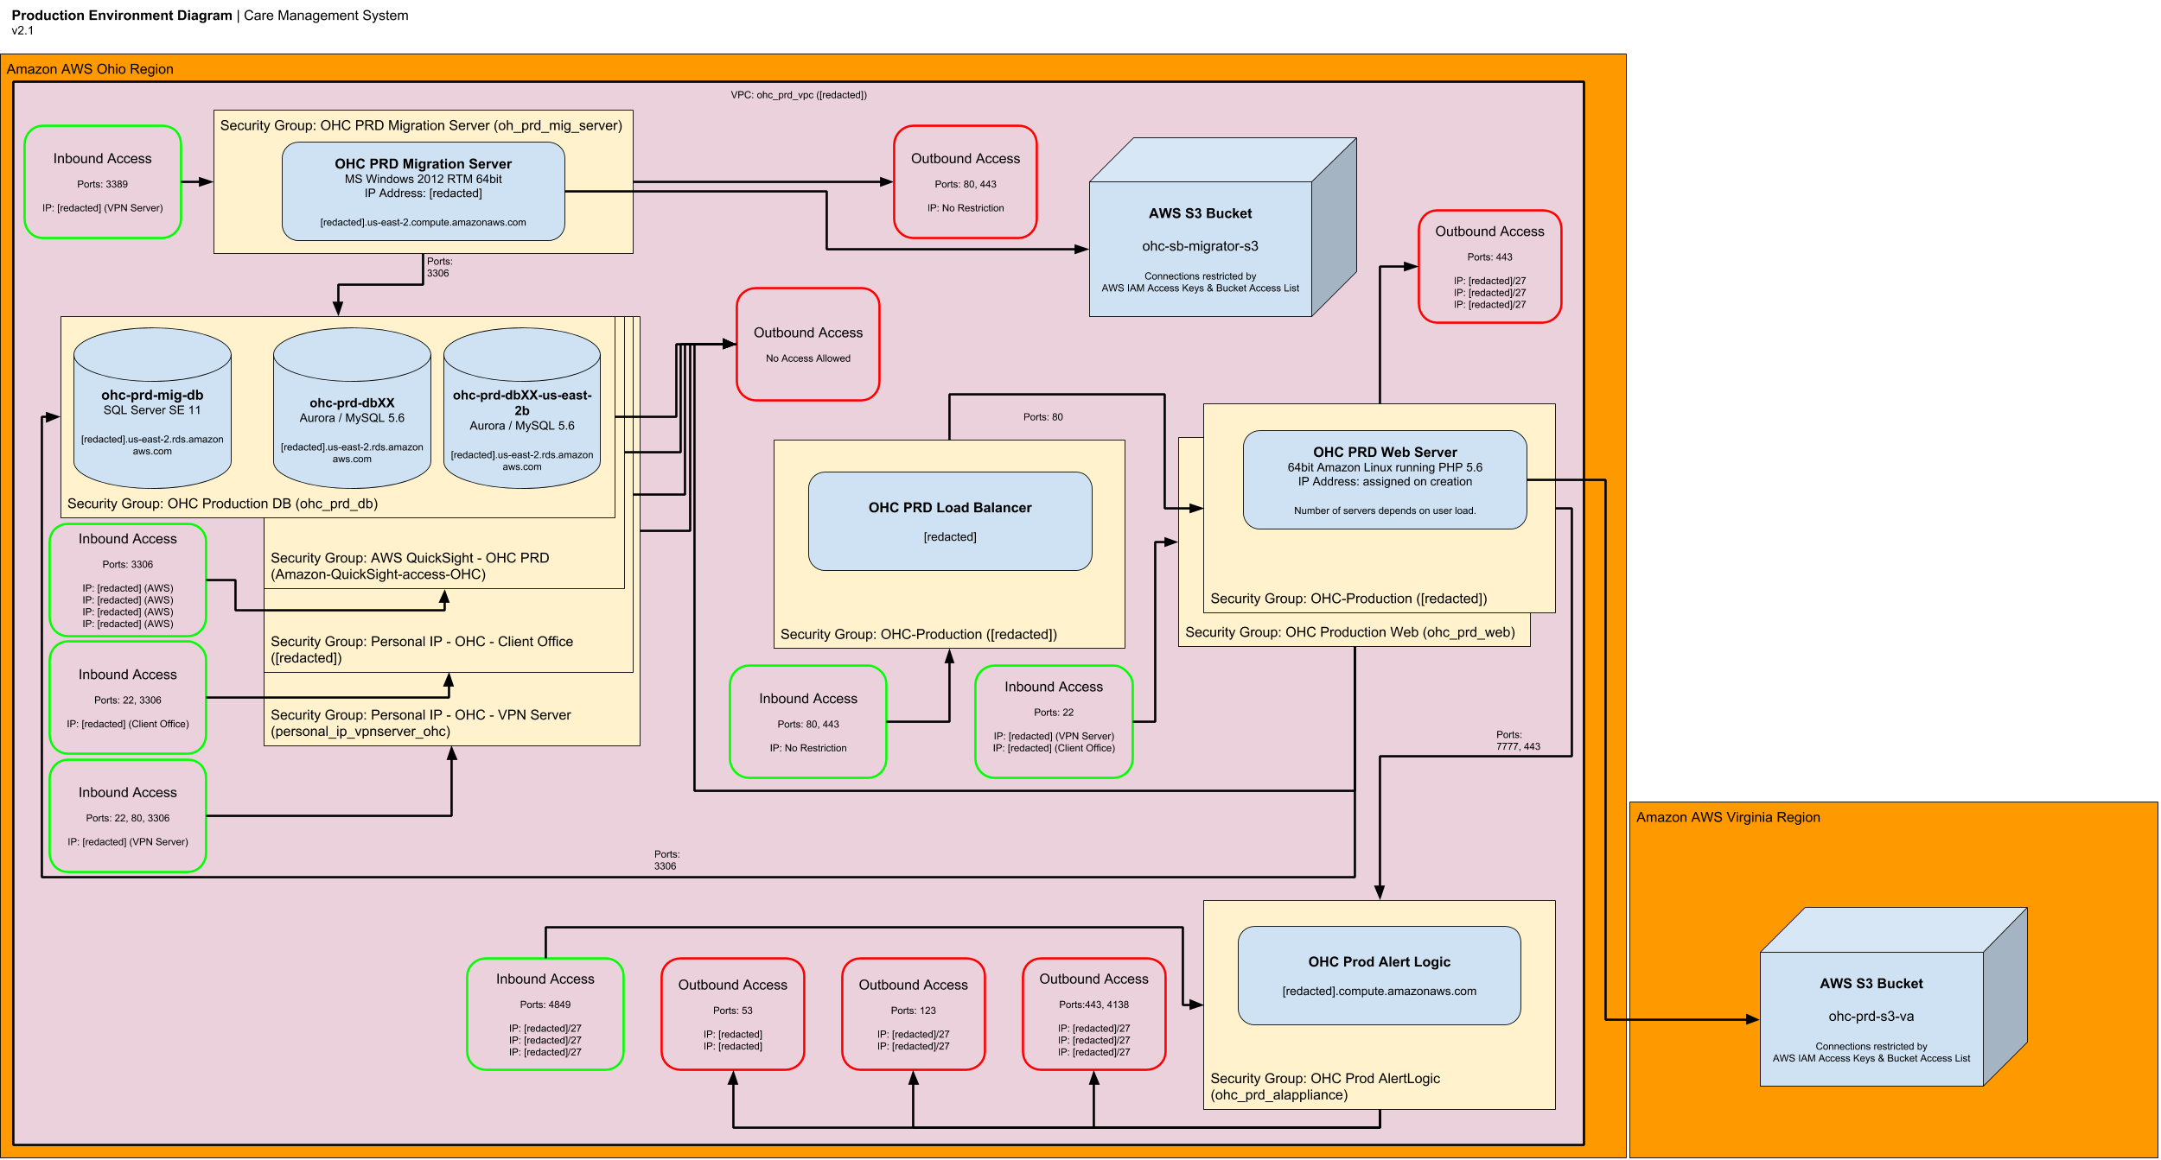

Slide 18
Web Servers
Notes:
VPN Server
Streamlined VPC Scheme
Scaling rules for EB

Slide 19
Web Servers - Legacy
Environment hosted on leased servers in shared datacenter.
Physical servers, which require significant time to on-board if new servers are necessary
Inconsistent backups, with minimal paths to restore in case of system failure
Notes:
Need for scaling, with servers being added & removed from load balanced pool as necessary based on usage
Easy way to deploy code changes in a rolling manner so that there is no noticeable down-time for end users during a deployment

Slide 20
Web Servers – New System
Based on AWS Elastic Cloud Compute (EC2) instances, environment scales as necessary based on load in the system
Using AWS Elastic Beanstalk (EB), code deployments are rolling, with individual servers being pulled out of load balancer pool one at a time for updates before being placed back into the pool
EB also monitors instance health and can terminate instances which are unhealthy after replacing them with new ones

Slide 21
Web Servers – Next Steps
Switch from Elastic Beanstalk to Cloud Formation
Provides more detailed control of process
Modify deployment process to always create new instances, instead of “upgrading” instances currently in use
Prevents system from developing “ghosts” based on areas of code which are not operating as efficiently as they should be

Slide 22
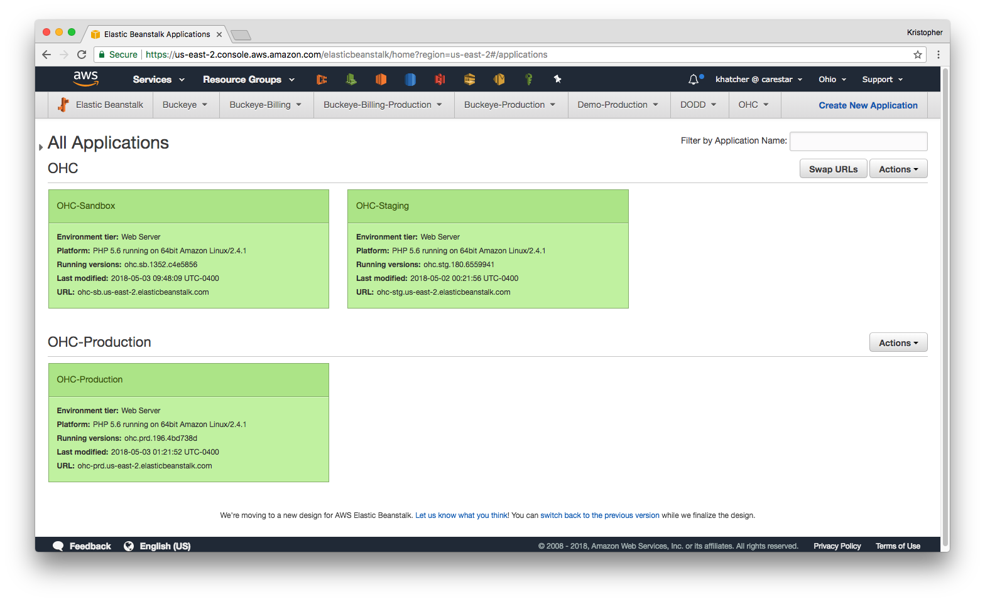

Slide 23
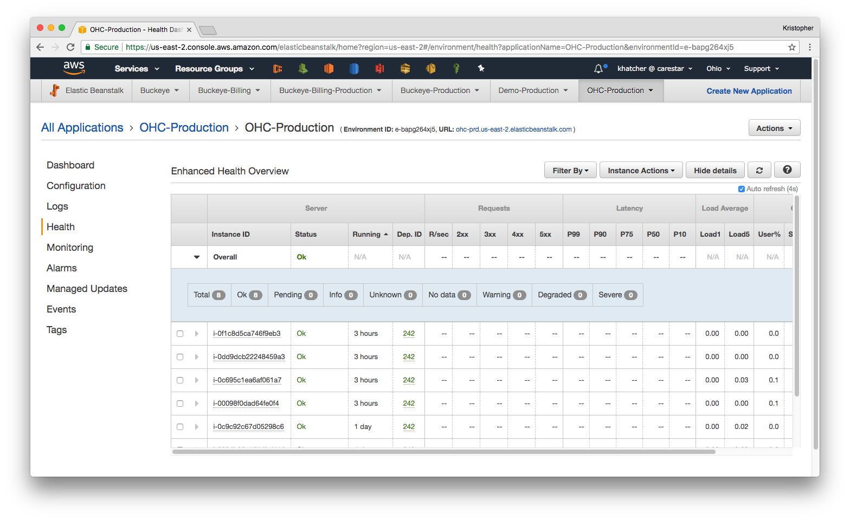

Slide 24
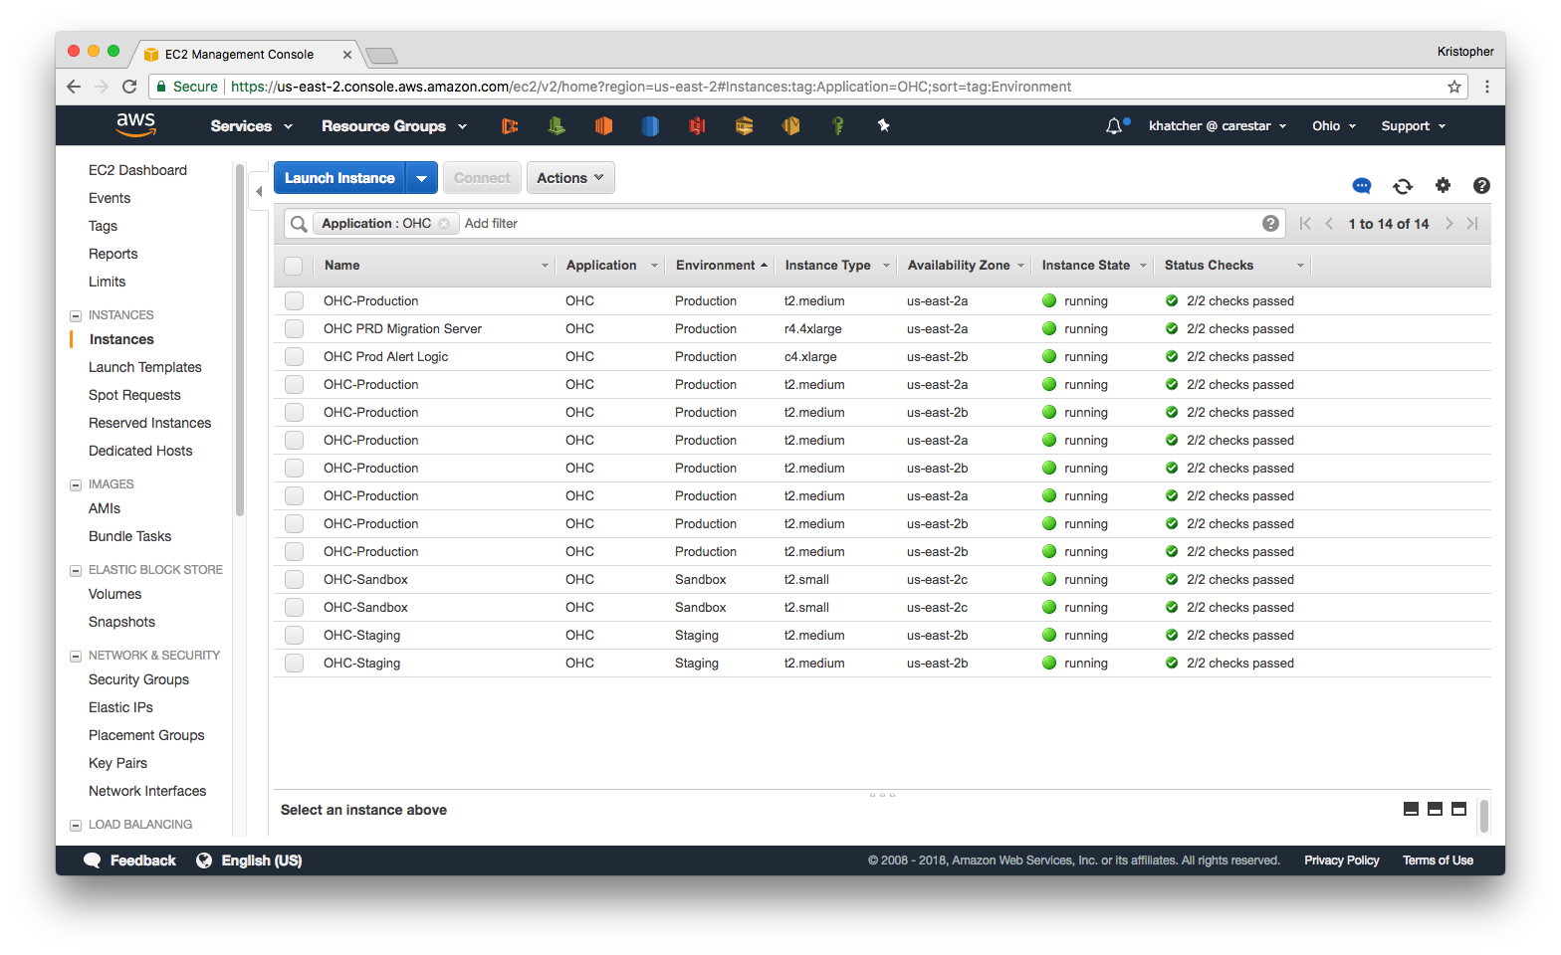

Slide 25
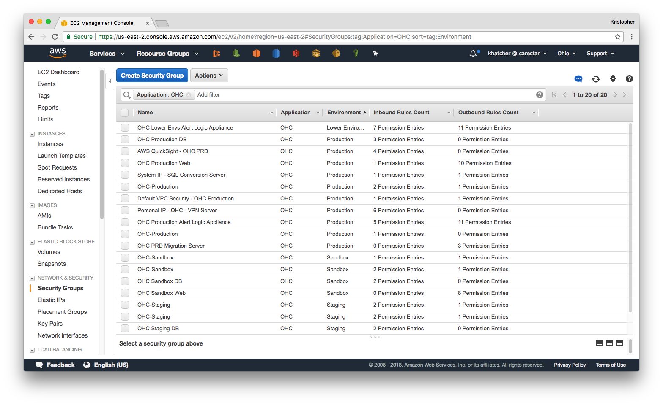

Slide 26
Databases
Notes:
VPN Server
Streamlined VPC Scheme
Scaling rules for EB

Slide 27
Databases - Legacy
Environment hosted on leased servers in shared datacenter.
Physical servers, which require significant time to on-board if new servers are necessary
Inconsistent backups, with minimal paths to restore in case of system failure
Microsoft SQL system, which drove costs up due to licensing fees
Notes:
PHI and PII concerns require encryption at rest for all data
Regular backups with simple, robust, proven methods for rolling back to a previous version
Allow for changes in database size so that future needs can be handled without significant work or major migration effort
Provide a robust tool for storing complex data structures in a manner which will allow fast and efficient transfers of data into and out of the instance

Slide 28
Databases – New System
Used AWS Relational Database Service (RDS) and their “Aurora” database, based on MySQL technology with enhancements to improve speed & efficiency in cloud environments
Flexible instance sizing provides the ability to have different sizes for different environments and to easily change that size as necessary
Built-in backup technology provides
Every transaction for the last 24 hours
Daily backups stored for a configurable length of time
Hot-standby servers in a separate Availability Zone and/or Region

Slide 29
Databases – Next Steps
Automated process to pull backups from Production into lower environments for debugging & development purposes
Including capability to scramble PII
Additional research to “right-size” the database instances to their use based on observed metrics
Modify Testing & Development environments to use Aurora Serverless to minimize costs in less-used environments

Slide 30
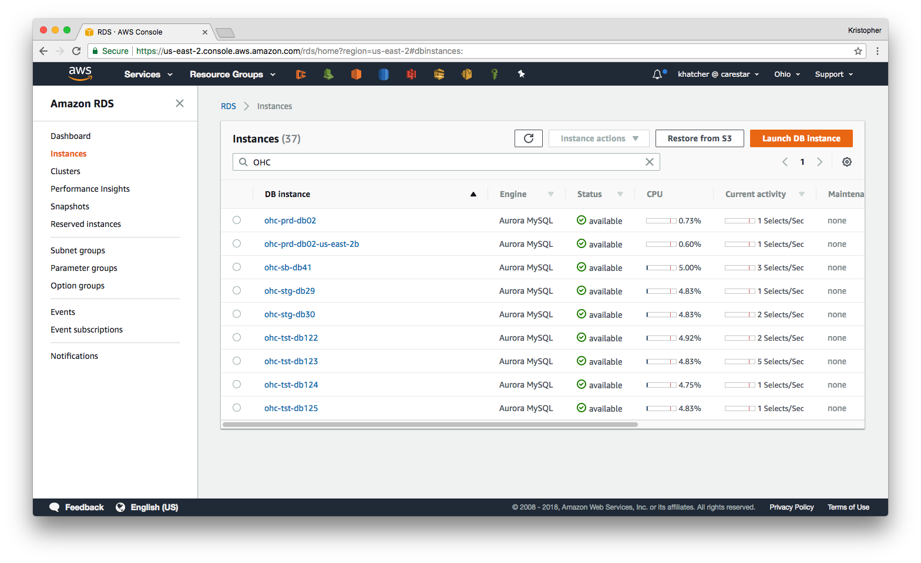

Slide 31
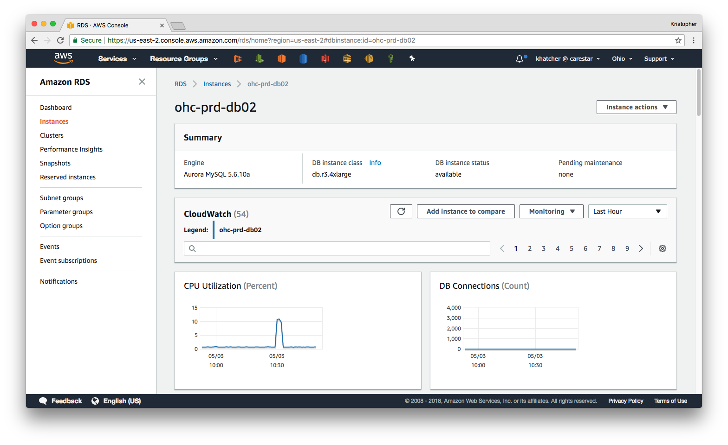

Slide 32
Document Storage
Notes:
VPN Server
Streamlined VPC Scheme
Scaling rules for EB

Slide 33
Document Storage - Legacy
Documents were stored on the web server
No specific backup system in place
Difficult to find documents for error report diagnosis

Slide 34
Document Storage – New System
Documents are now stored in AWS Simple Storage Service (S3)
Unified organizational structure provides ease of finding documents when necessary for error research
AWS S3 provides built-in redundancy protections, promising 99.999999999% durability
Notes:
11 9s of durability
For example, if you store 10 million objects with Amazon S3, you can on average expect to incur a loss of a single object once every 10 thousand years.

Slide 35
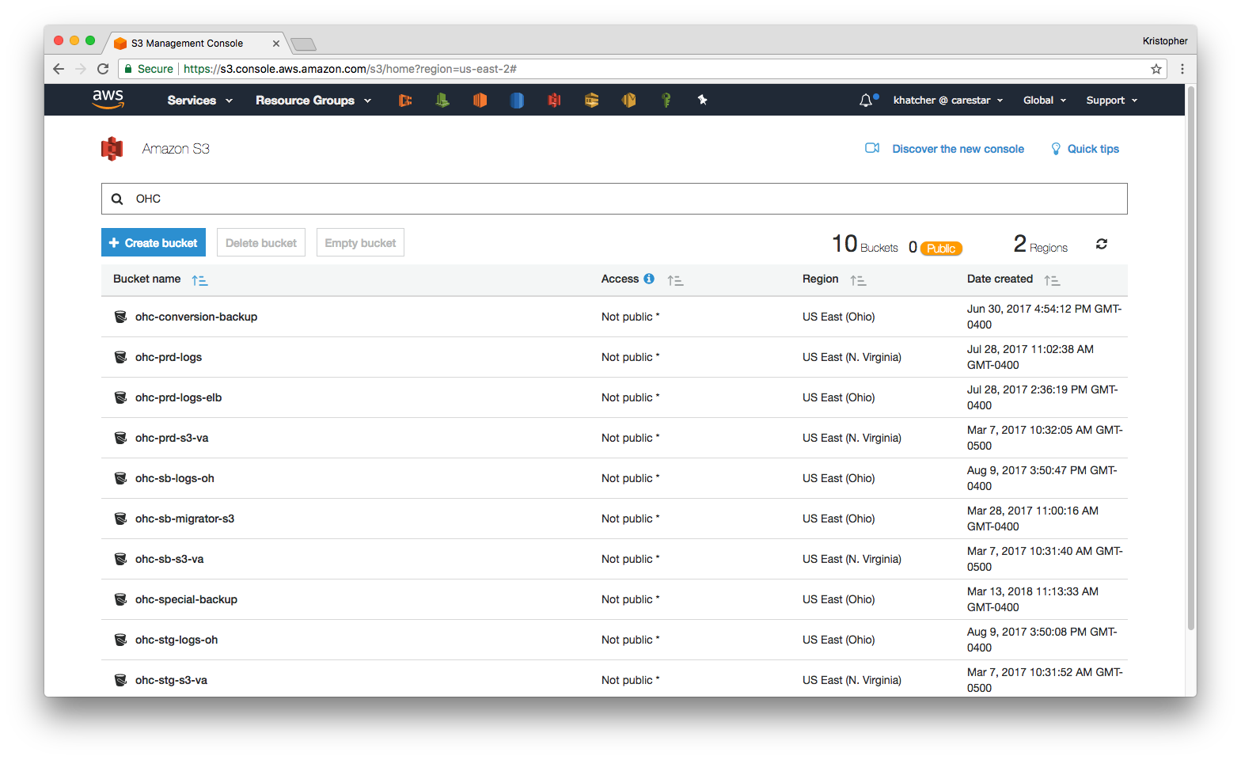

Slide 36
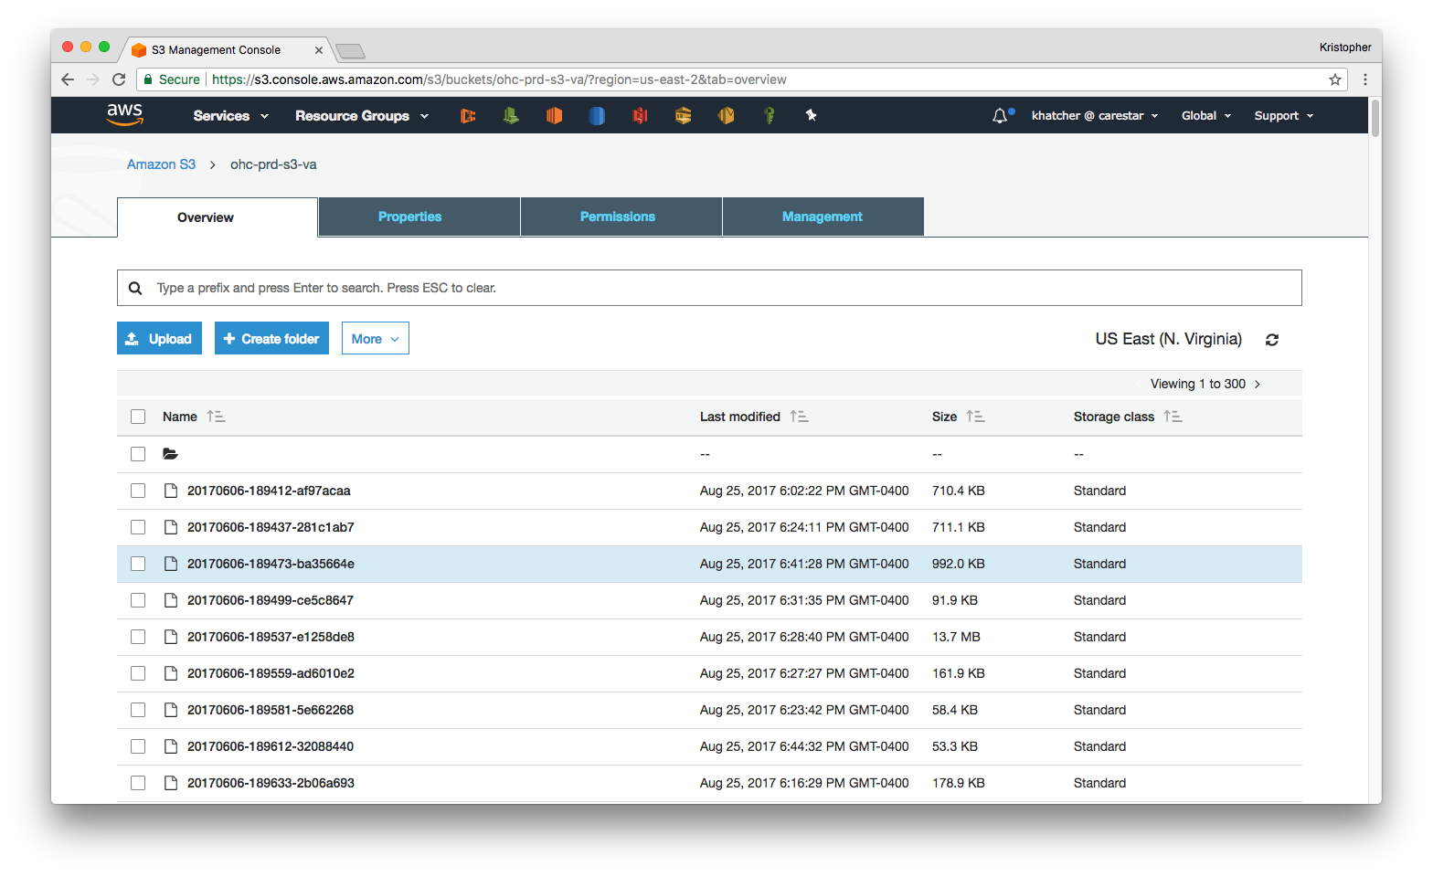

Slide 37
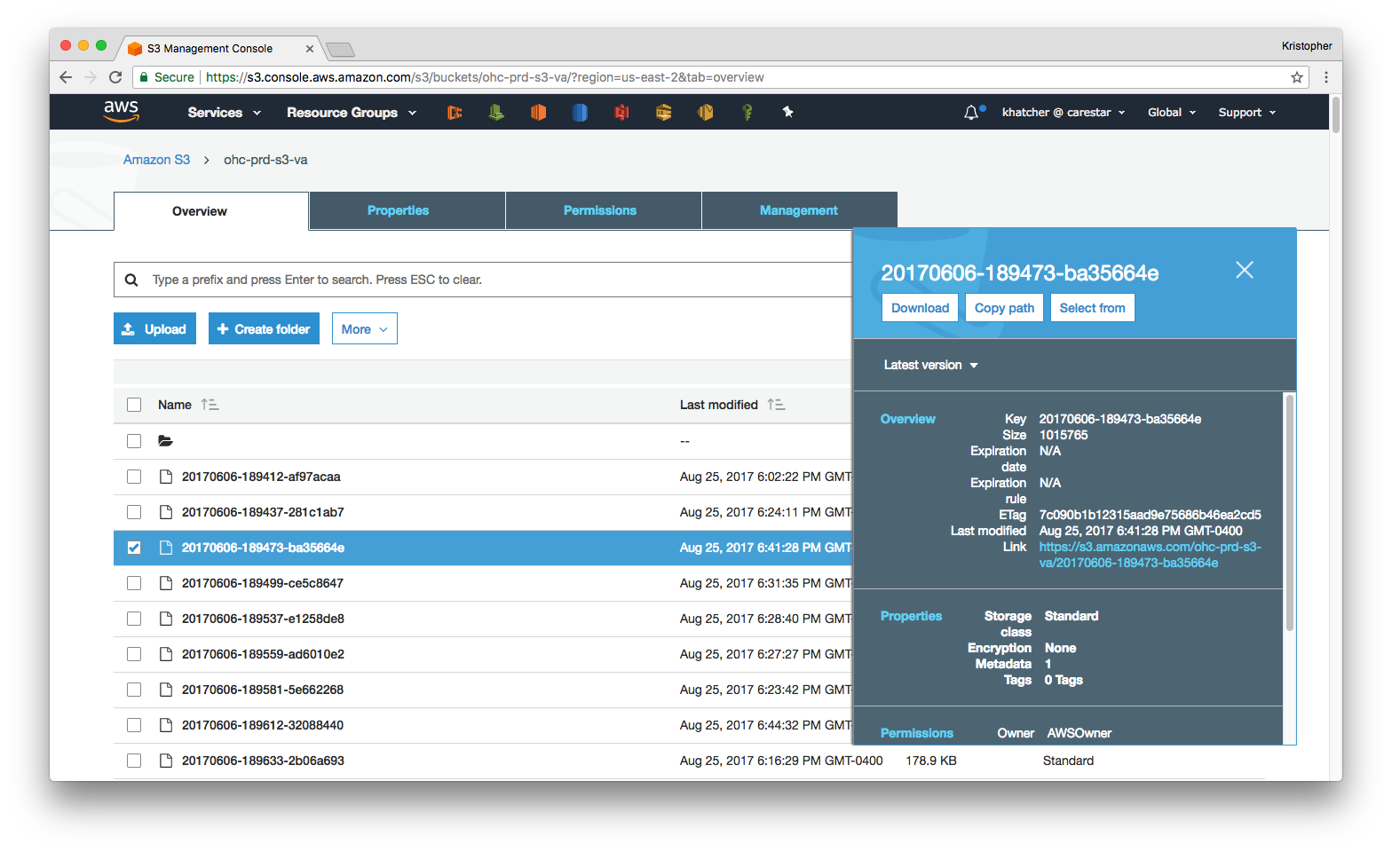

Slide 38
Infrastructure
Notes:
VPN Server
Streamlined VPC Scheme
Scaling rules for EB

Slide 39
Infrastructure – Legacy
No testing environments
Physical servers
No scaling

Slide 40
Infrastructure – New System
Each application (6 total) has Sandbox, Staging, and Production environments
Each production application is in it’s own VPC, with access restricted and monitored
Creating environments for new applications is a documented process that can be completed by anyone with a basic understanding of AWS
All environments scale web instances based on usage
All infrastructure for an environment is right-sized to that environment’s needs and use-case

Slide 41
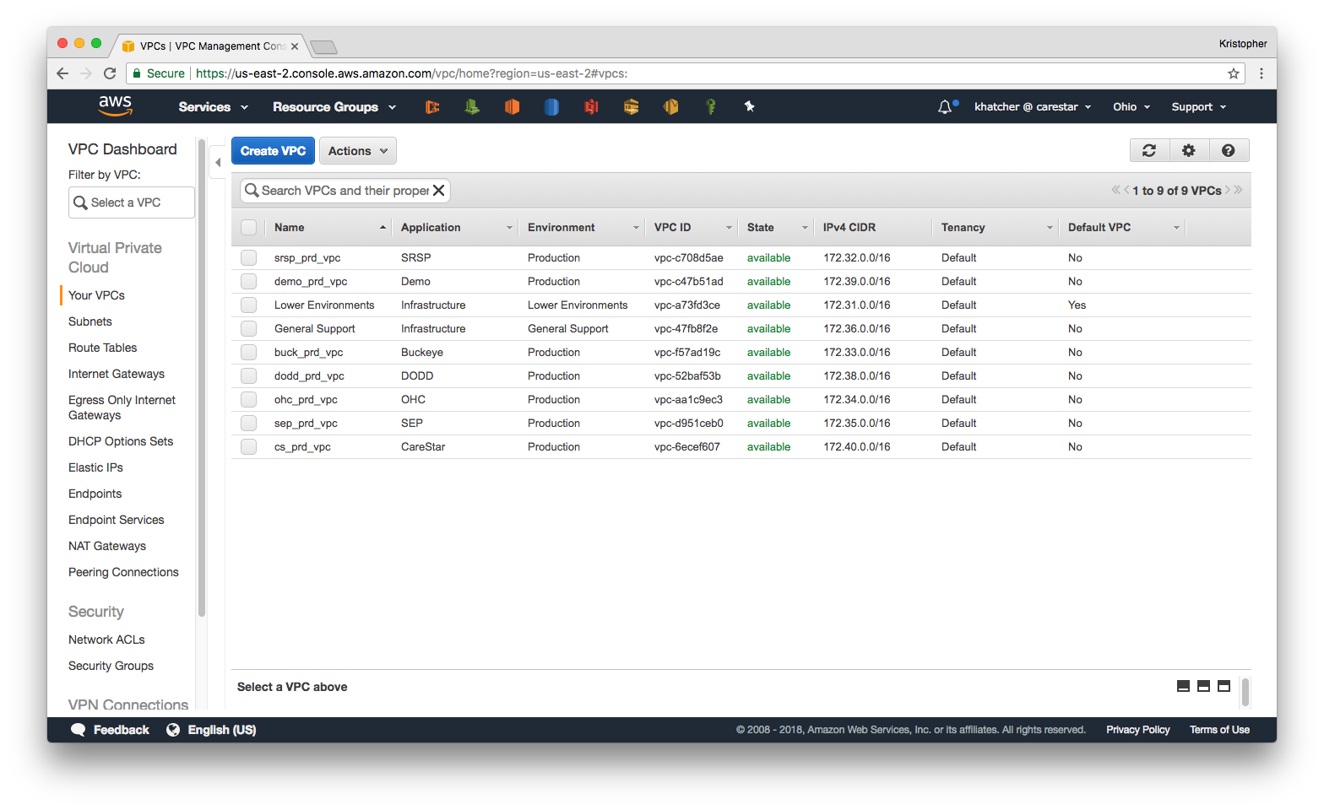

Slide 42
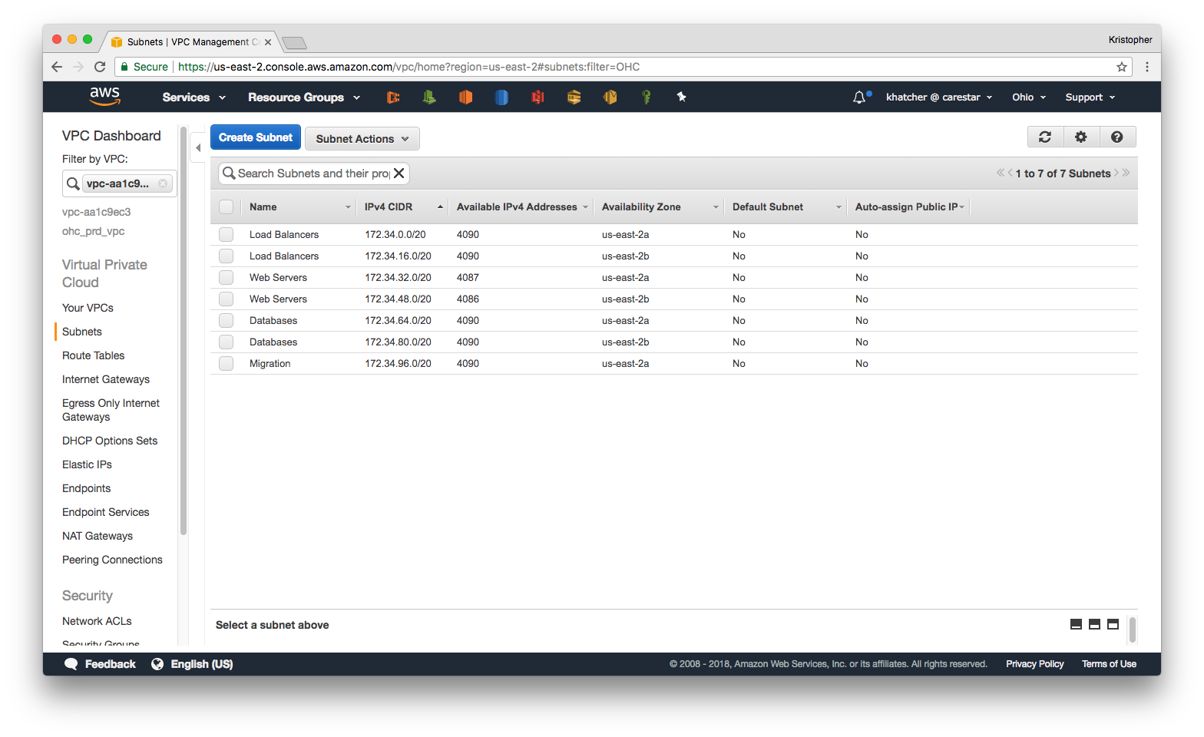

Slide 43
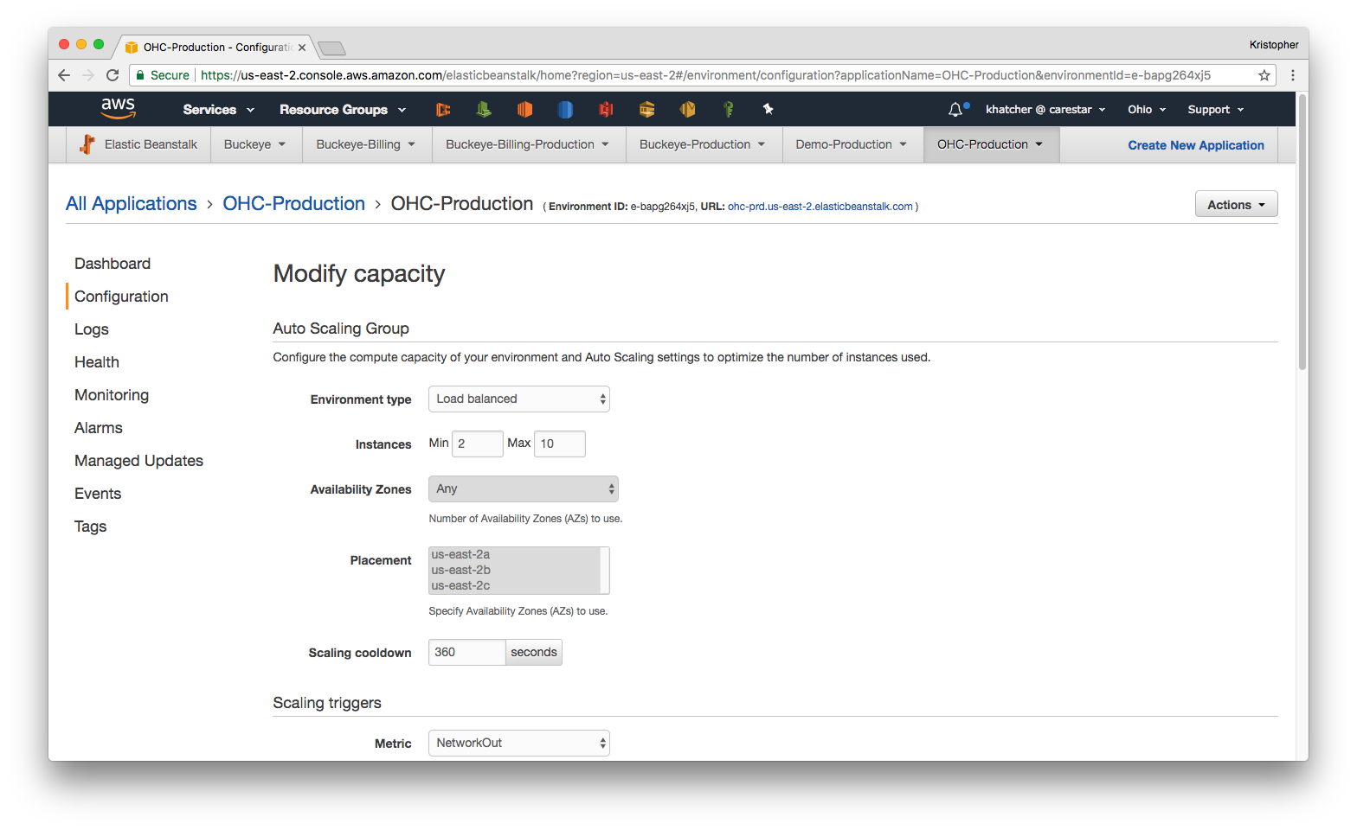

Slide 44
Lessons Learned & Next Steps
Notes:
Use CloudFront instead of EB
Start out with Gen Support VPC
Documentation, or pairing, is critical

Slide 45
Lessons Learned & Next Steps
Separate general infrastructure
Use Elastic Beanstalk for rapid prototyping and initial development, then use Cloud Formation for long-term implementation and Production use-cases
Take advantage of AWS tools to minimize spend on non-critical portions of system
Notes:
General Infrastructure – TeamCity & VPN into Gen Support VPC
Minimize Spend – Storage types in S3 (Standard, Standard-Infrequent Access, Glacier, & new Standard-Single AZ)

Slide 46
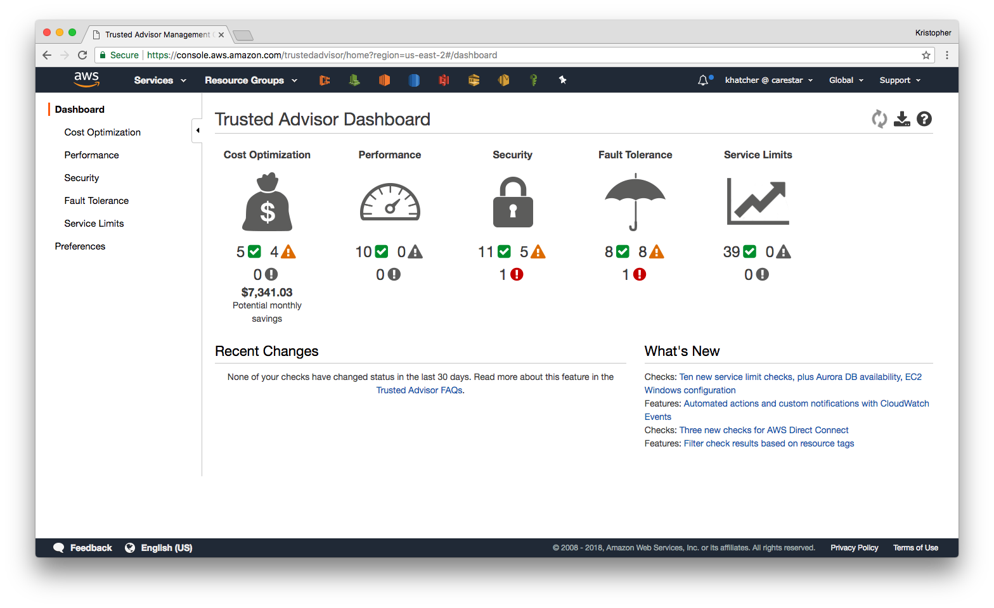
Notes:
Client’s monthly bill for April was over $22K
Savings of $7K would be a more than 30% drop in monthly cost!

Slide 47
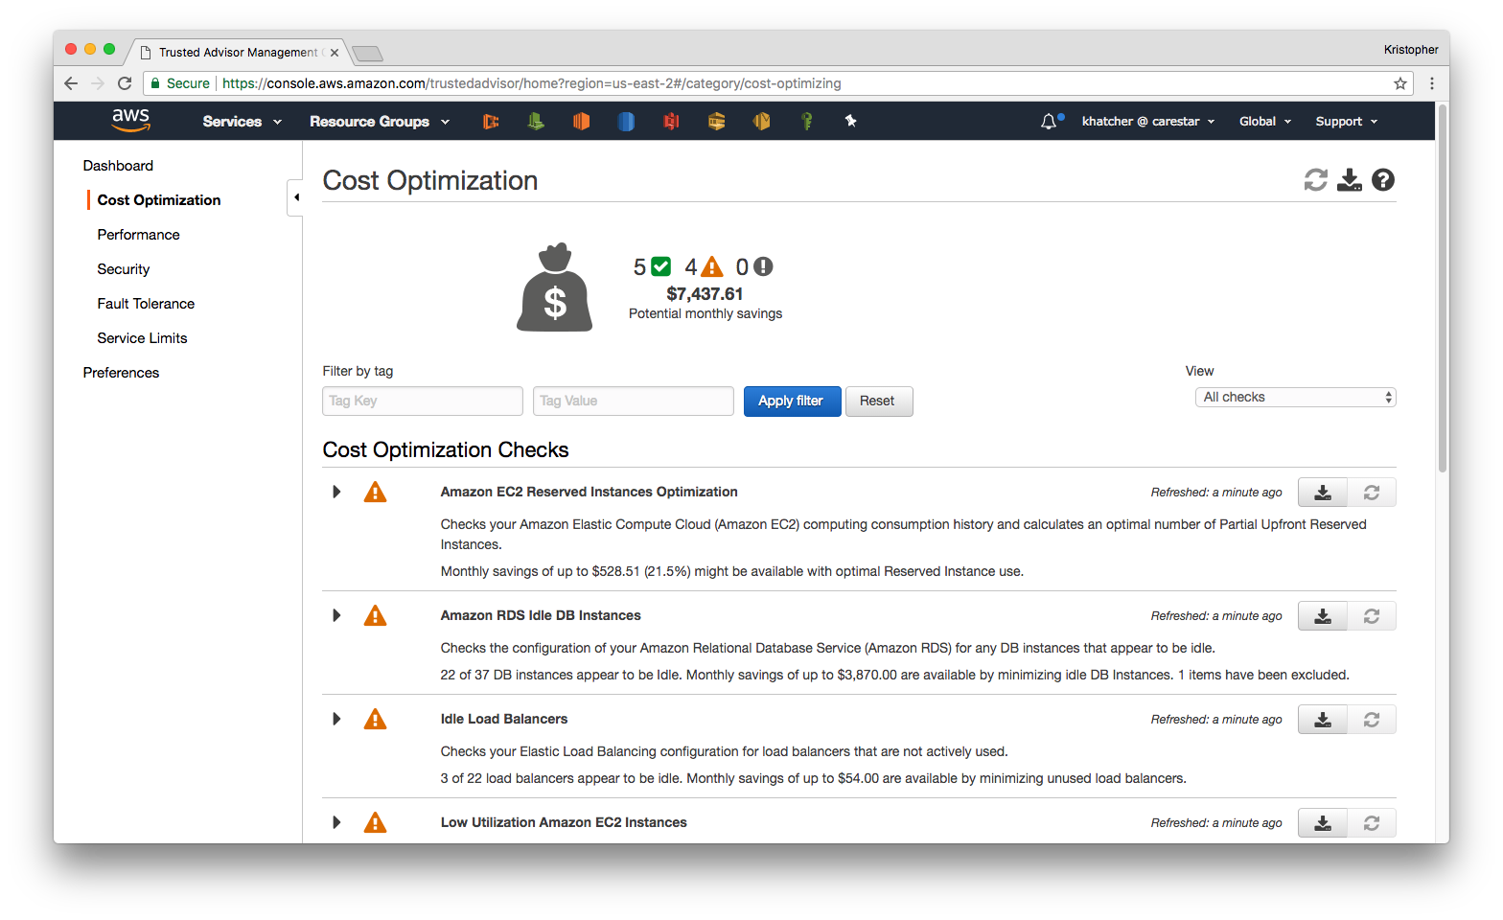

Slide 48
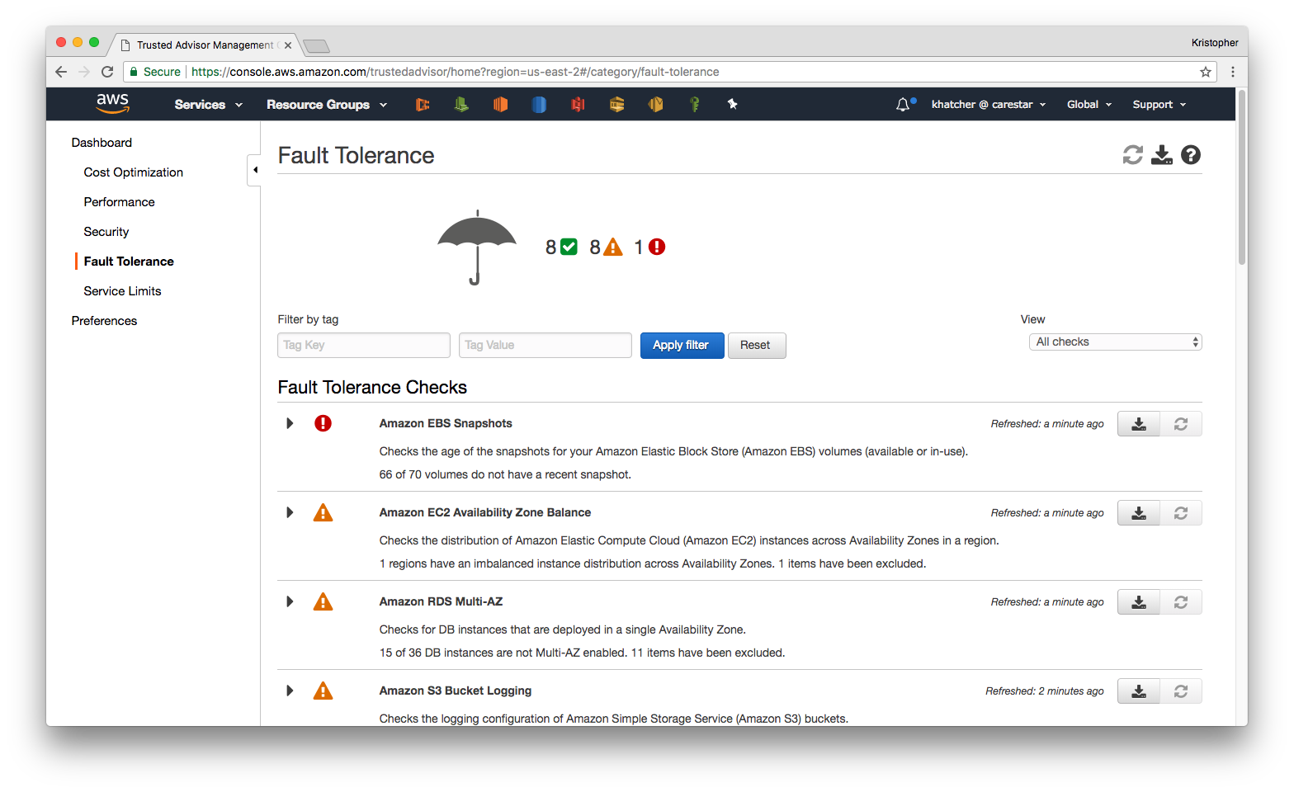

Slide 49
Thank you!
speakerdeck.com/krishatcher/climbing-the-elastic-beanstalk
linkedin.com/in/krishatcher/

